Slide 1
HABs with Sentinel-2

Slide 2
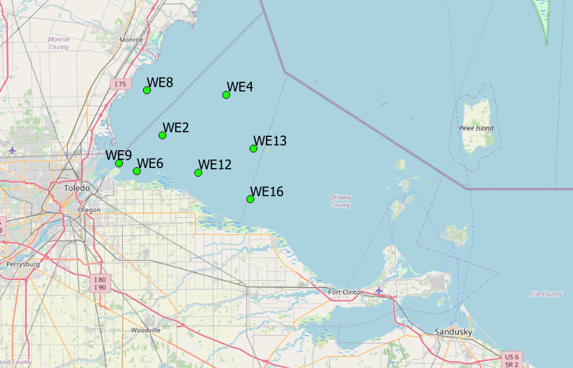
Background
HABs: Harmful Algal Blooms. Come from eutrophication.
Sentinel-2: 10m resolution monitoring satellite
Images every point on Earth every 15 days
Study Area: SW Lake Erie
Set of 8 HAB monitoring stations run by NOAA
Some with continuous monitoring, some with field sampling only

Slide 3
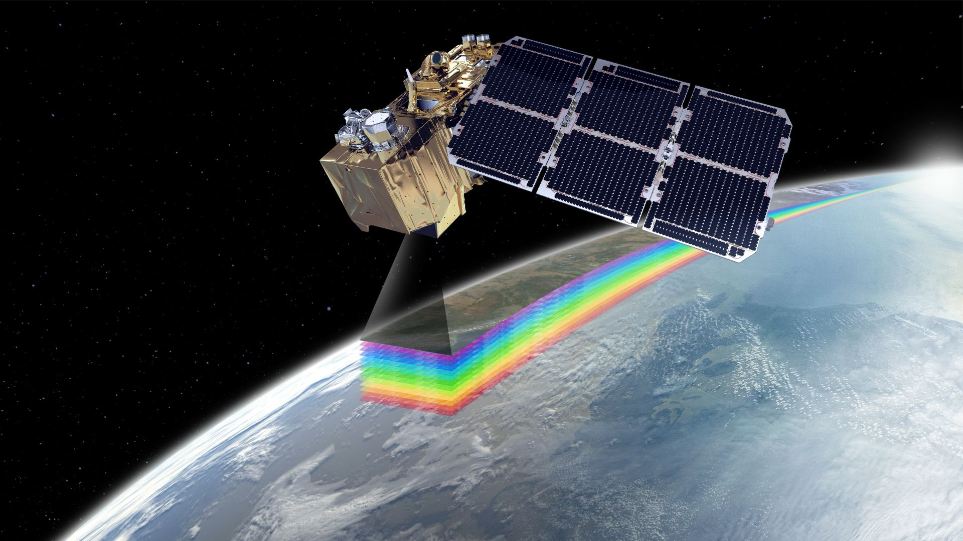
Data
Data from HAB stations publically available from NOAA (2014-present)
632 Sentinel-2 images in area
Masked clouds
Sampled mean pixel intensity within 50m of stations
Downloaded as CSV – joined together
649 observations over 120 distinct dates
Possible problems
Joining field data results in few observations – 649 becomes 24
Buoy data and field data not comparable b/c of differing units

Slide 4
Goals
Determine band combinations most useful for detecting HABs
Use turbidity measurements to prevent conflating turbid water with algae blooms
Generalize the model to nearby pixels in SW Lake Erie

